Slide 1
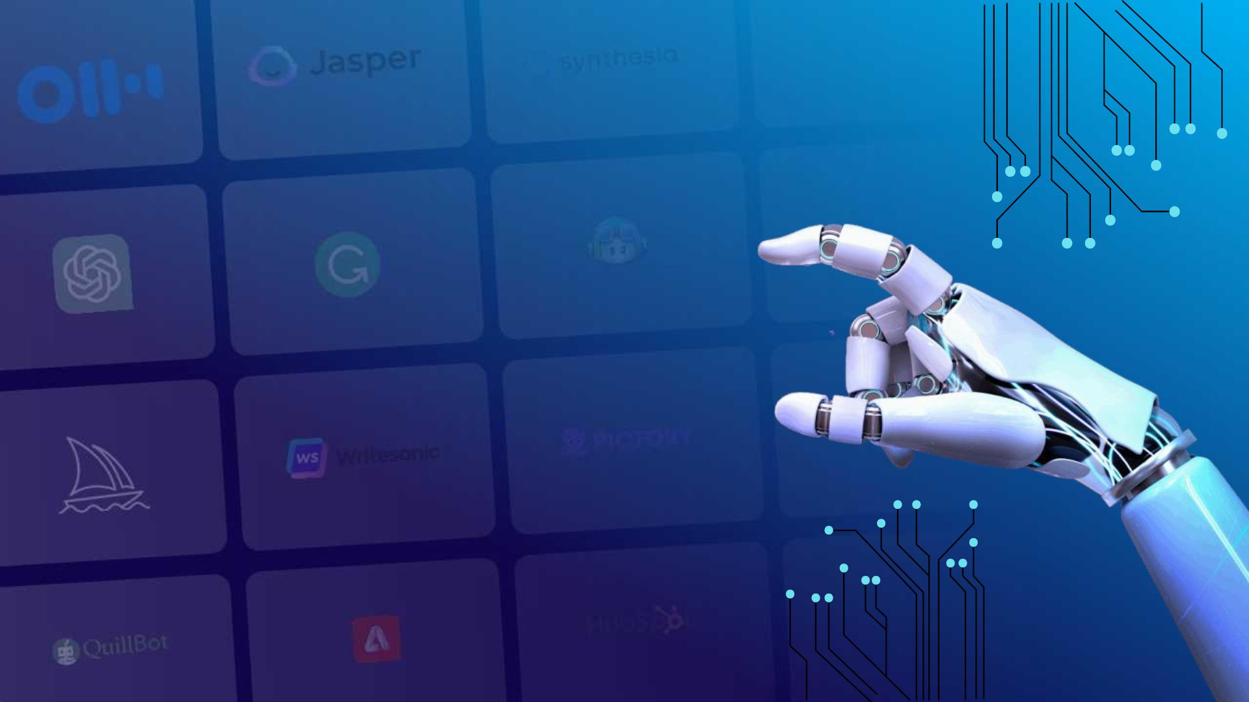
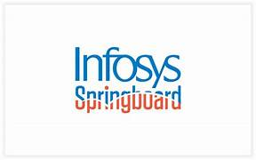
Smart Stock: Inventory Optimization for Retail Stores
AI-Based Retail Inventory Forecasting System
Guided by:
SAKTHI GOPALAKRISHNAN
1

Slide 2

Team Members
SAKSHI
BHAKTHI S P
ARAVINDA
CHARISHMA
CHANNABASAVA
Developed the front-end, back-end functionalities, integrated the chatbot, and coordinated overall system development.
Implemented back-end logic for overstock and understock inventory.including admin and manager login authentication and role-based access.
Developed the cities and stores management module for multi-location inventory tracking.
Managed the SQLite database and prepared documents.
Created the project report and and assisted with supporting project tasks.

Slide 3


Problem Statement
Lack of Real-Time Inventory Visibility
Manual tracking and delayed updates cause stockouts, overstock, and no unified view of inventory.
Inaccurate Demand Prediction
Traditional methods struggle with large datasets like FreshRetail50K, leading to poor forecasts and inventory loss.
Operational Inefficiencies Across Multiple Stores
No automated alerts and slow data sync increase storage costs and reduce customer satisfaction.
2

Slide 4

Core Objectives
AI Agent
Primary Objective
Machine Learning & Forecasting
To develop an inventory optimization system that predicts product demand and monitors stock in real time.
Implement GBoost-based sales forecasting.
Develop real-time inventory dashboard.
Backend Development & APIs
User Management
Build Node.js REST APIs.
Integrate Sqlite database.
Enable Admin and Store Manager authentication.
Deploy the system on Render cloud.
3

Slide 5
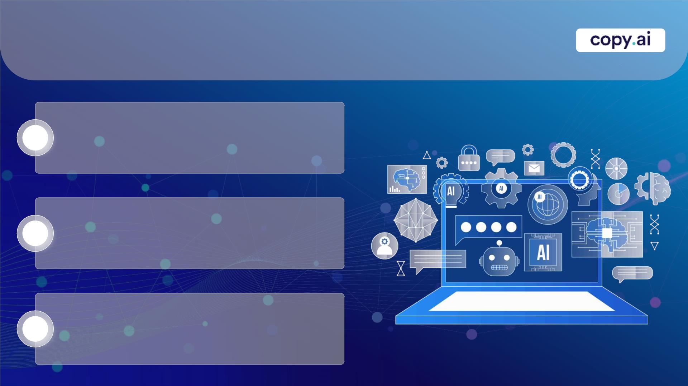
Dataset – Random
Medium-Scale Retail Data:
Contains 50+ records of daily sales, stock, and store information across multiple cities.
1
2
3
Time-Series Format:
Includes historical sales, stock levels, discounts, and holiday/activity flags for demand forecasting.
Challenges:
High volume and complexity make manual analysis difficult, requiring ML models like XGBoost for accurate predictions.
4

Slide 6

Key Features
AI-based Sales Forecasting – using XGBoost to predict future demand per store
Real-time Inventory Tracking – monitor stock levels across multiple stores and cities
Automated Alerts – notifications for understock and overstock items
Role-based Authentication – Admin & Manager access control
Interactive Dashboard – displays stock levels, forecasts, and insights
Analytics & Reports – visualize sales trends, category performance, inventory turnover, and more
AI Chatbot Assistant – provides quick inventory insights and recommendations

Slide 7

Tools and Technologies
Backend & Frameworks
Python
Node.js
Next.js(App Router)
Next.js API Routers
REST APIs
Typescripts
React (Server & client Components)
Database & Storage
Sqlite
Development
GitHub
VS Code
Postman
Frontend
React.js
Next.js (App Router)
TypeScript
HTML5
CSS3
Tailwind CSS
Radix UI
Responsive Web Design
Machine Learning
XGBoost
Pandas
NumPy

Slide 8
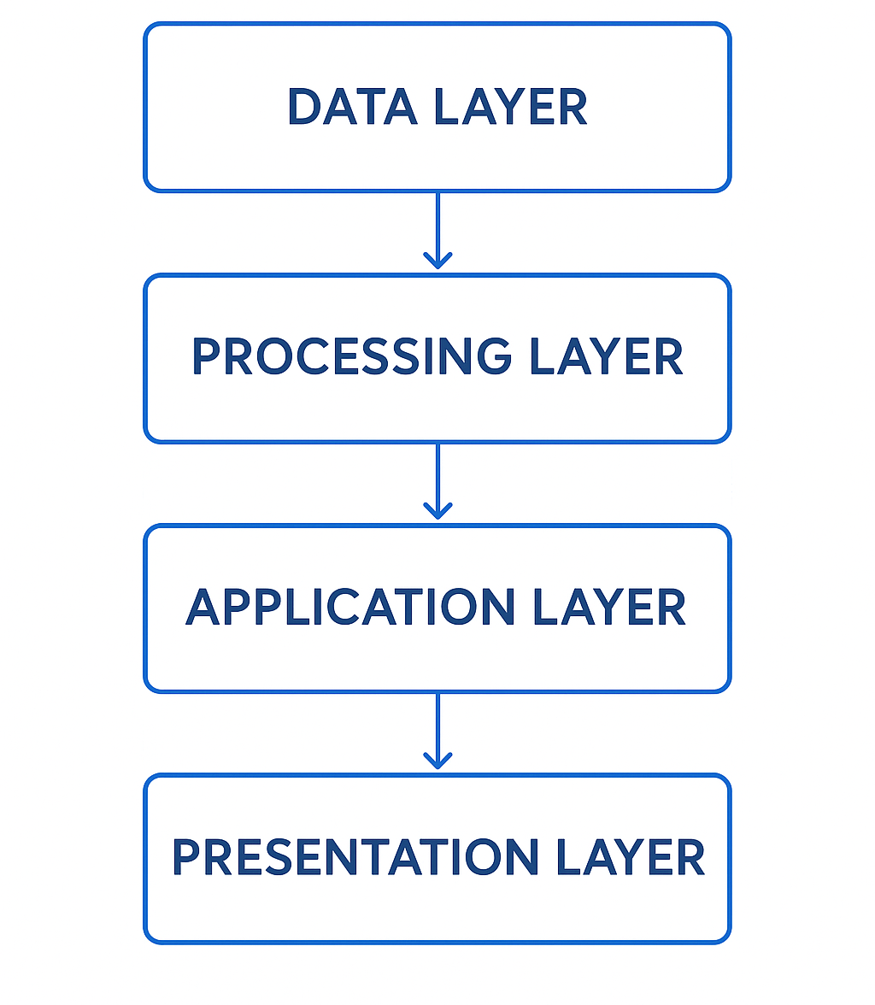
Layers of System
1️⃣ Data Layer
This layer handles all data storage and sources required by the system.
Historical sales dataset – contains sales, inventory, and store-level data
SQLite Database – stores structured data for querying, reporting, and analysis
2️⃣ Processing Layer
This layer prepares data and builds the machine learning model.
Data preprocessing – cleaning, normalization, and formatting of raw data
Feature engineering – creation of meaningful features for forecasting
XGBoost model training – offline training of demand forecasting model
Model persistence – saving trained models for reuse
3️⃣ Application Layer
Node.js – runtime for executing server-side JavaScript
Next.js (App Router) – framework for building server-rendered React applications
Next.js API Routes – backend endpoints to handle requests
REST APIs – endpoints for client-server communication
TypeScript – ensures type safety and maintainable code
Prediction service – loads saved ML model and returns forecasts
4️⃣ Presentation Layer
This is the user interface, what the user sees and interacts. Includes:
Web-based dashboard → displays sales, stock, alerts, and forecasts.
Inventory monitoring tables → track real-time stock across stores.

Slide 9
System Flow
User → Web UI:
The user interacts with a web-based dashboard to view inventory, sales, and forecasts.
Web UI → Flask API:
Requests from the UI are sent to the Flask backend API for processing and data retrieval.
Flask API → ML Model (XGBoost):
The backend passes relevant sales and stock data to the XGBoost model for 7-day demand forecasting.
ML Model → Database:
Predictions and processed data are stored or updated in the cloud PostgreSQL database for centralized access.
Database → Dashboard Output:
The dashboard fetches real-time data and displays stock status, alerts, and forecast insights to the user.
User
Web UI
Flask API
ML model
XG Boost
Database
Dashboard
Output

Slide 10
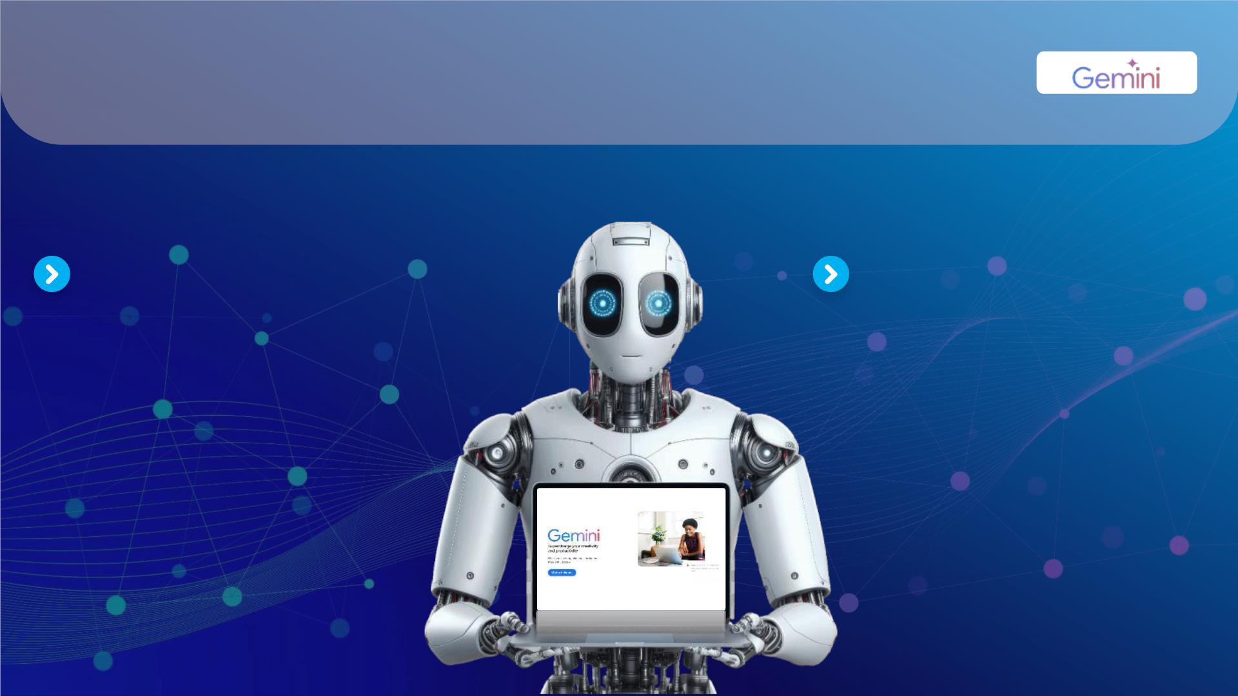
Implementation
BACKEND IMPLEMENTATION
  Framework Used: Flask (Python)
  Core Functionalities:
  • User Login Authentication
  • Inventory Data Retrieval
  • Forecast Prediction API
  • Stock Status Classification
  • Alert System Generation
  • Sqlite Integration
  Backend Workflow:
  Fetch data from database
  Run XGBoost predictions
  Compare stock vs forecast
  Generate status & alerts
  Send output to dashboard
FRONTEND DASHBOARD
  Dashboard Displays:
  • City • Sales
  • Available Stock • Store ID
  • Predicted Sales • Product ID
  • Stock Status • Date
  Frontend Technologies:
  React Js
  Dashboard Features:
  • Real-time monitoring
  • Multi-store support
  • Clean tabular visualization
  • Responsive UI

Slide 11
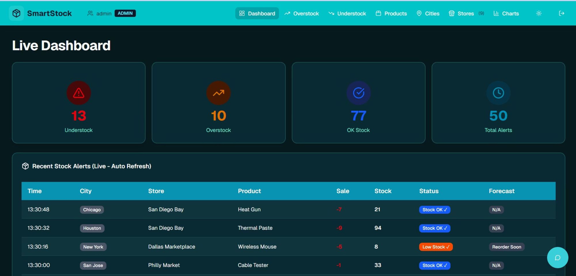
Live Inventory Dashboard
This dynamic dashboard provides an immediate, comprehensive overview of your retail operations. It displays essential real-time inventory metrics, current stock levels across all locations, critical low-stock alerts, and recent transaction data. This enables managers to monitor performance, identify trends, and make informed decisions swiftly to prevent stockouts and optimise product availability.

Slide 12
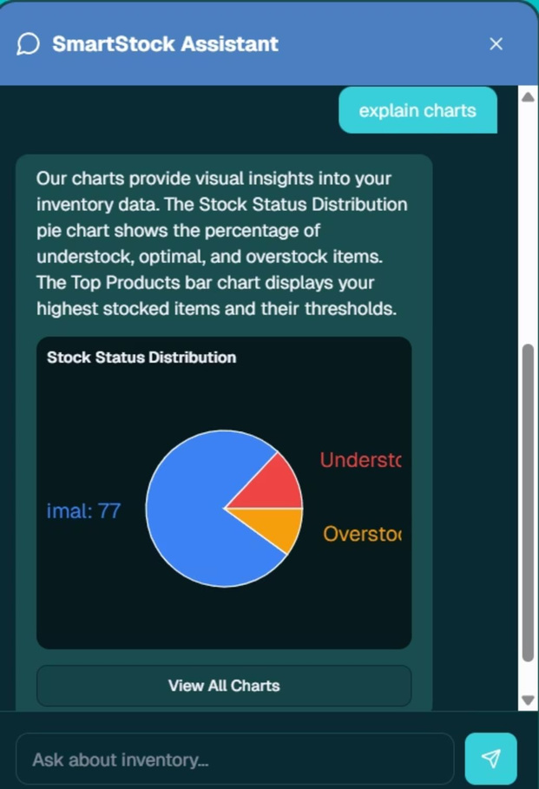
SmartStock Assistant Dashboard
The SmartStock Assistant Dashboard provides a comprehensive visual overview of your retail inventory. It offers real-time insights into key metrics, allowing for quick analysis of stock levels, optimal distribution across locations, and detailed product performance. This intuitive interface empowers managers to make data-driven decisions swiftly, ensuring efficient operations and maximised profitability.

Slide 13
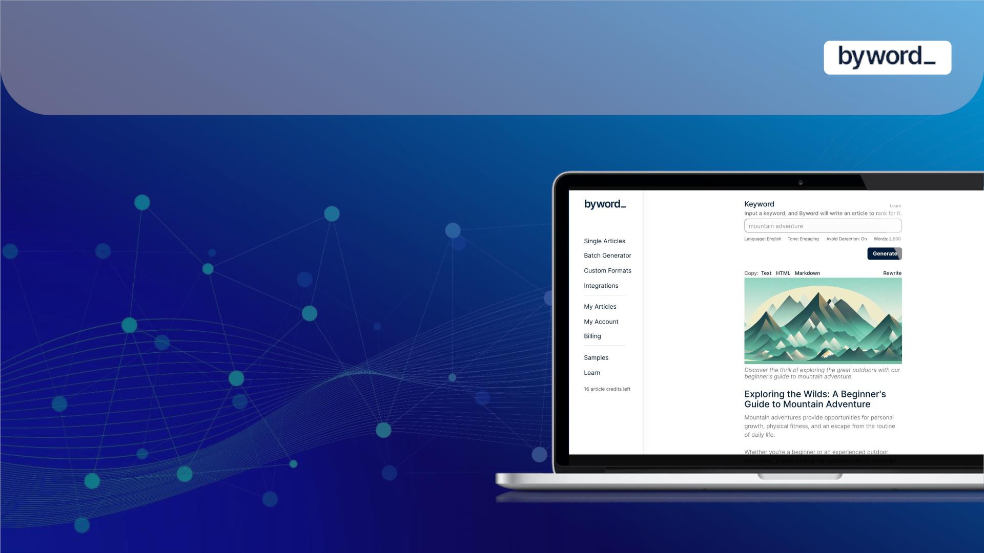
Conclusion
This project delivers an efficient AI-driven inventory forecasting system that accurately predicts sales and supports real-time stock monitoring across multiple stores. By integrating XGBoost modeling with a Flask backend, sqlite database, and cloud deployment, the system ensures reliable performance and seamless data flow. The dashboard provides clear, actionable insights that help improve inventory decisions and reduce stockouts, demonstrating the practical value of machine learning in retail operations.

Slide 14
THANK YOU

